Slide 1
key logger and security
CAPSTONE PROJECT
Presented By:
SATHYADEVI.P-JKKN CET-B.TECH-IT

Slide 2
OUTLINE
Problem Statement (Should not include solution)
Proposed System/Solution
System Development Approach (Technology Used)
Algorithm & Deployment
Result (Output Image)
Conclusion
Future Scope
References

Slide 3
Problem Statement
In today's digital age, where cybersecurity threats loom large, one of the significant concerns is the proliferation of keyloggers, stealthy software tools designed to monitor and record keystrokes on a user's computer without their knowledge. Keyloggers pose a severe threat to individuals and organizations as they can capture sensitive information such as passwords, credit card details, and other personal data, leading to identity theft, financial loss, and privacy breaches.

Slide 4
Proposed Solution
One of the most effective solutions to combat keyloggers and protect against their threats is to employ a multi-layered approach to cybersecurity. Here are some strategies individuals and organizations can implement:
Use Reliable Antivirus and Antimalware Software: Invest in reputable antivirus and antimalware software that can detect and remove keyloggers and other malicious software from your systems.
Ensure that the software is regularly updated to stay ahead of emerging threats.
Enable Firewall Protection: Activate firewalls on your devices and networks to block unauthorized access and prevent keyloggers from communicating with external servers.
Keep Operating Systems and Software Updated: Regularly update operating systems, applications, and software to patch known vulnerabilities that could be exploited by keyloggers and other malware.

Slide 5
Proposed Solution
Practice Safe Browsing Habits: Exercise caution when clicking on links or downloading attachments from unknown or suspicious sources. Phishing emails and malicious websites are common vectors for keylogger infections.
Use Virtual Keyboards for Sensitive Inputs: Whenever possible, utilize virtual keyboards for entering sensitive information such as passwords and credit card details. Virtual keyboards can thwart keyloggers by allowing users to input characters using mouse clicks or touchscreen gestures instead of physical keystrokes.
Implement Strong Password Policies: Encourage the use of complex, unique passwords for each account and consider implementing two-factor authentication (2FA) to add an extra layer of security.

Slide 6
Proposed Solution
Regularly Monitor Systems for Suspicious Activity: Employ intrusion detection systems (IDS) and security information and event management (SIEM) solutions to monitor for signs of unauthorized access or suspicious behavior indicative of keylogger activity.
Encrypt Sensitive Data: Utilize encryption techniques to protect sensitive data both at rest and in transit. This can help mitigate the risk of data interception by keyloggers.
Educate Users: Provide cybersecurity awareness training to employees and end-users to educate them about the risks of keyloggers and best practices for preventing infections.
Implement Endpoint Security Solutions: Deploy endpoint security solutions that include features such as behavior monitoring, heuristic analysis, and sandboxing to detect and block keyloggers in real-time.

Slide 7
System Approach
The "System Approach" section outlines the overall strategy and methodology for developing and implementing the rental bike prediction system. Here's a suggested structure for this section:
Identify System Components
Assess Vulnerabilities
Implement Protective Measures
Technical Controls
Technical Control

Slide 8
Algorithm & Deployment
Algorithmic Approach:
Keylogger Detection Algorithm:
Develop an algorithm capable of detecting keyloggers on various platforms (Windows, macOS, Linux, etc.).
The algorithm should analyze system processes, registry entries, file system changes, and network traffic patterns to identify suspicious behavior indicative of keylogger activity.
Utilize machine learning techniques to continuously improve detection accuracy based on historical data and emerging threat patterns.
Real-time Monitoring Algorithm:
Implement an algorithm for real-time monitoring of keystrokes and system activities.
Monitor keyboard input events and compare them against known patterns of keylogger behavior.
Develop algorithms for analyzing the behavior of installed applications and processes.
Flag processes exhibiting keylogger-like behavior, such as capturing keystrokes, accessing sensitive files, or making unauthorized network connections.
Employ sandboxing techniques to isolate suspicious processes and analyze their behavior in a controlled environment.
Response and Mitigation Algorithm:
Define response actions based on the severity of keylogger detections.

Slide 9
Algorithm & Deployment
Deployment Considerations:
Scalability and Performance:
Ensure that the algorithms are designed to scale across large enterprise environments without compromising performance.
Implement parallel processing and distributed computing techniques to handle high volumes of data efficiently.
Integration with Security Infrastructure:
Integrate the keylogger detection algorithms with existing security infrastructure, including antivirus software, firewalls, and intrusion detection systems.
Develop APIs and interfaces for seamless integration with security information and event management (SIEM) platforms for centralized monitoring .
Continuous Monitoring and Updates:
Implement mechanisms for continuous monitoring of system activities and updating the algorithms to adapt to evolving threats.
Establish a process for receiving and incorporating threat intelligence feeds from external sources to enhance detection capabilities.
User Education and Training:
Provide user education and training on the purpose and functionality of the keylogger detection system.
Communicate the importance of reporting any suspicious activities or system anomalies to the IT security team promptly.
Compliance and Regulatory Requiremet

Slide 10

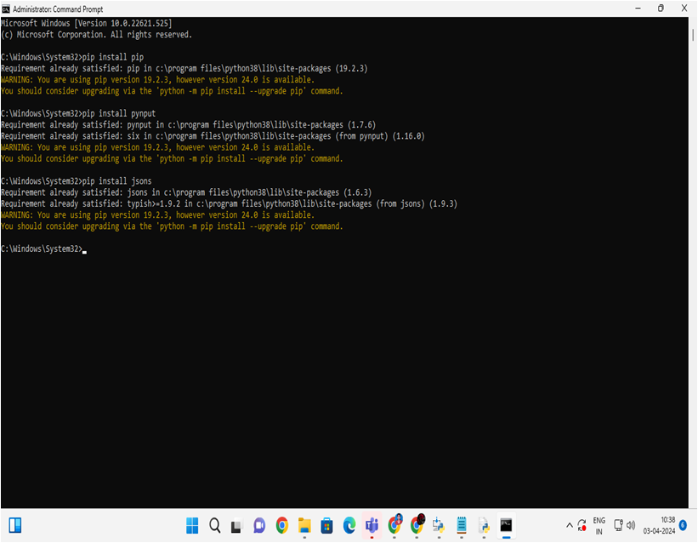
Algorithm & Deployment

Slide 11


RESULT

Slide 12
Result
The implementation of comprehensive cybersecurity measures, including the deployment of keylogger detection modules and employee education, results in heightened protection against keyloggers, reduced risk of data breaches, and improved incident response capabilities..

Slide 13
Conclusion
In conclusion, by adopting a systematic approach that combines technical solutions, employee awareness, and continuous monitoring, organizations can effectively mitigate the threats posed by keyloggers and enhance their overall cybersecurity posture.

Slide 14
Future scope
Enhancing keylogger detection algorithms through advancements in artificial intelligence and deep learning, along with the integration of blockchain technology for secure and immutable logging of keystroke data.

Slide 15
References
To address the keylogger problem, organizations should regularly update their security policies and practices by referring to reputable sources such as cybersecurity frameworks, industry best practices, and guidance from trusted organizations like NIST (National Institute of Standards and Technology) or CIS (Center for Internet Security)..

Slide 16
THANK YOU

